Slide 1


AI in Healthcare: Transforming Medicine
Artificial intelligence (AI) is revolutionizing healthcare by improving diagnostics, treatment, and patient outcomes. This presentation explores AI applications, benefits, challenges, and future prospects in medicine.
by Lourdu Virgin Maria Paul Savariraj

Slide 2
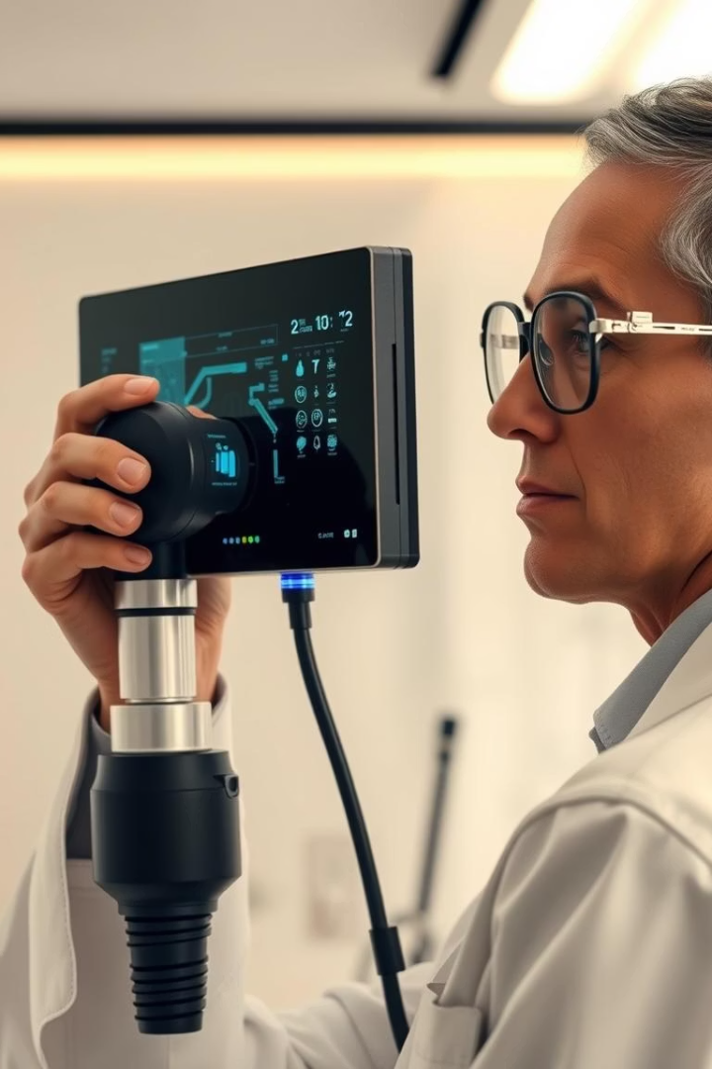
AI Enhancing Diagnostics Accuracy
Medical Imaging
Pathology Analysis
AI algorithms detect diseases like cancer earlier from X-rays and MRIs.
Automated tissue examination ensures more precise and faster results.
Predictive Analytics
AI models predict patient risks using historical data and symptoms.

Slide 3
AI-Powered Personalized Treatment
Precision Medicine
Drug Development
Treatment Optimization
Tailoring therapies based on genetic, lifestyle, and environmental data.
AI accelerates discovery of effective new drugs and reduces costs.
Adaptive treatment plans improve patient recovery and reduce side effects.

Slide 4
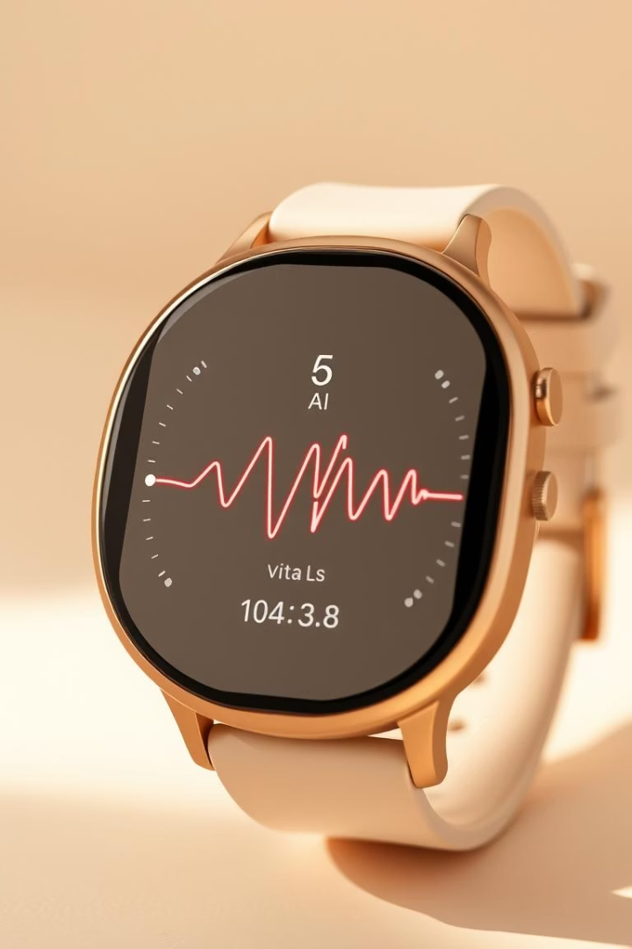



AI in Patient Monitoring
Continuous Monitoring
Wearables track vital signs and detect abnormalities early.
Remote Patient Care
Telemedicine enabled by AI supports patients outside hospitals.
Real-time Alerts
AI sends immediate notifications for critical health changes.

Slide 5

Challenges in AI Adoption
Data Privacy
Ensuring patient confidentiality while processing sensitive information.
Algorithm Bias
Addressing biases to prevent disparities in healthcare delivery.
Regulatory Approval
Meeting stringent standards for safety and efficacy in medical AI.
Integration Complexity
Incorporating AI smoothly into existing healthcare workflows.

Slide 6

Future Prospects of AI in Healthcare
Advanced Robotics
Enhancing precision in surgeries and rehabilitation processes.
AI-Driven Drug Discovery
Shortening development timelines with complex molecule analysis.
Population Health Management
Predicting epidemics and improving public health strategies.

Slide 7
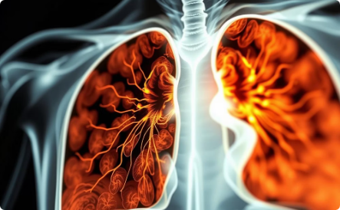


Success Stories of AI in Healthcare
Lung Cancer Detection
AI algorithms increase early diagnosis rates significantly.
Robotic Surgery
Minimally invasive procedures with AI improve recovery times.
Diabetes Management
AI-enabled glucose monitoring improves daily disease control.

Slide 8





Key Takeaways & Next Steps
Embrace AI Tools
Adopt AI to enhance care quality and efficiency.
Address Challenges
Focus on ethics, privacy, and bias mitigation.
Invest in Training
Educate healthcare staff on AI capabilities and use.
Collaborate for Innovation
Partner across disciplines to accelerate AI adoption.

